Slide 1
what is a 360 video booth
https://sites.google.com/view/360-video-booth-rental-arcadia/home
Notes:
https://drive.google.com/drive/folders/11FS9t4cO3mzuaRgZXZ55ix9U3FdVcwHn?usp=sharing
https://docs.google.com/document/d/17Pfl9vPBwpBSfR0UoU0OdTldB90I5lx_ig5gGJNwI8Q/edit?usp=sharing
https://docs.google.com/document/d/17Pfl9vPBwpBSfR0UoU0OdTldB90I5lx_ig5gGJNwI8Q/pub
https://docs.google.com/document/d/17Pfl9vPBwpBSfR0UoU0OdTldB90I5lx_ig5gGJNwI8Q/view
https://docs.google.com/presentation/d/1tdjZGJOE37rGEOPwGspAL0u3gbc_ss-g0b1UtyKydPo/edit?usp=sharing
https://docs.google.com/presentation/d/1tdjZGJOE37rGEOPwGspAL0u3gbc_ss-g0b1UtyKydPo/pub
https://docs.google.com/presentation/d/1tdjZGJOE37rGEOPwGspAL0u3gbc_ss-g0b1UtyKydPo/view
https://docs.google.com/document/d/19QnYAPPxW-abcJnN-I3TfPSHdZNgnp2kQNVwyEczMXA/edit?usp=sharing
https://docs.google.com/document/d/19QnYAPPxW-abcJnN-I3TfPSHdZNgnp2kQNVwyEczMXA/pub
https://docs.google.com/document/d/19QnYAPPxW-abcJnN-I3TfPSHdZNgnp2kQNVwyEczMXA/view
https://docs.google.com/presentation/d/1r_Vgs_OoDV5FS02RNWz6nEIqFePvrSLagqTDY-lmCok/edit?usp=sharing
https://docs.google.com/presentation/d/1r_Vgs_OoDV5FS02RNWz6nEIqFePvrSLagqTDY-lmCok/pub
https://docs.google.com/presentation/d/1r_Vgs_OoDV5FS02RNWz6nEIqFePvrSLagqTDY-lmCok/view
https://docs.google.com/document/d/1dkhJHG4N32f3Si8ZMHCv90F5T0uubfwcKMRi9WLAJiw/edit?usp=sharing
https://docs.google.com/document/d/1dkhJHG4N32f3Si8ZMHCv90F5T0uubfwcKMRi9WLAJiw/pub
https://docs.google.com/document/d/1dkhJHG4N32f3Si8ZMHCv90F5T0uubfwcKMRi9WLAJiw/view
https://docs.google.com/presentation/d/1hqwZxAs7xRcPoTFoVjCzzMGqEUoyl51GS7eIsFzQCtA/edit?usp=sharing
https://docs.google.com/presentation/d/1hqwZxAs7xRcPoTFoVjCzzMGqEUoyl51GS7eIsFzQCtA/pub
https://docs.google.com/presentation/d/1hqwZxAs7xRcPoTFoVjCzzMGqEUoyl51GS7eIsFzQCtA/view
https://docs.google.com/document/d/12EKzXOX9UxbW-APamcHgXDpZf9jaI04YYHT_T0YrDcI/edit?usp=sharing
https://docs.google.com/document/d/12EKzXOX9UxbW-APamcHgXDpZf9jaI04YYHT_T0YrDcI/pub
https://docs.google.com/document/d/12EKzXOX9UxbW-APamcHgXDpZf9jaI04YYHT_T0YrDcI/view
https://docs.google.com/presentation/d/1EWzma3V-gaypjpMUd7m-q-21rMNhVLWJaiVCI3tCsj4/edit?usp=sharing
https://docs.google.com/presentation/d/1EWzma3V-gaypjpMUd7m-q-21rMNhVLWJaiVCI3tCsj4/pub
https://docs.google.com/presentation/d/1EWzma3V-gaypjpMUd7m-q-21rMNhVLWJaiVCI3tCsj4/view
https://docs.google.com/document/d/10FisUyDwvIpUJ3h9p1kJvjq4NCJmwk9tRkFOvR6exBU/edit?usp=sharing
https://docs.google.com/document/d/10FisUyDwvIpUJ3h9p1kJvjq4NCJmwk9tRkFOvR6exBU/pub
https://docs.google.com/document/d/10FisUyDwvIpUJ3h9p1kJvjq4NCJmwk9tRkFOvR6exBU/view
https://docs.google.com/presentation/d/1z-Hys4eRc3ZOt9ml88xkCEtpjpDiPZb70FD_Tr_fpHs/edit?usp=sharing
https://docs.google.com/presentation/d/1z-Hys4eRc3ZOt9ml88xkCEtpjpDiPZb70FD_Tr_fpHs/pub
https://docs.google.com/presentation/d/1z-Hys4eRc3ZOt9ml88xkCEtpjpDiPZb70FD_Tr_fpHs/view
https://docs.google.com/document/d/1STmD_qZYrQYtJyzJET3gNjFwsxXI3_nDdbANiGOPPKM/edit?usp=sharing
https://docs.google.com/document/d/1STmD_qZYrQYtJyzJET3gNjFwsxXI3_nDdbANiGOPPKM/pub
https://docs.google.com/document/d/1STmD_qZYrQYtJyzJET3gNjFwsxXI3_nDdbANiGOPPKM/view
https://docs.google.com/presentation/d/1TU5I3SMLY2RQ4NMGbP9jrGRuyumnlnY5haIb80FtpTg/edit?usp=sharing
https://docs.google.com/presentation/d/1TU5I3SMLY2RQ4NMGbP9jrGRuyumnlnY5haIb80FtpTg/pub
https://docs.google.com/presentation/d/1TU5I3SMLY2RQ4NMGbP9jrGRuyumnlnY5haIb80FtpTg/view

Slide 2
what is a 360 video booth
Without any engaging content or activity, your party or event may turn out to be tedious for your guests. I have a challenge for you. Let's take a moment to learn about the newest trend in event technology, the 3D 360 degree photo booth! In this article, we'll explore the changes that this innovation has brought to events as well as its benefits for event organizers and guests. Your party or event isn't going to have any challenging moments if you have a 360-degree photo booth. It's a revolutionary innovation for event organizers and hosts. 360 or 360-degree photo booth, the term refers to the most innovative booth of the era. 360 degree photo booth has completely changed the way people feel about events and conferences. It has also solved the difficulty of finding engaging activities at an event for the attendees. The 360-degree photo booth has emerged as a revolutionary innovation for event organizers and hosts.
https://sites.google.com/view/360-video-booth-rental-arcadia/home
Notes:
360 video booth rental near me,360 video booth rental los angeles,360 video booth rental price,360 video booth price,360 video booth automatic,what is a 360 video booth,360 video booth business,360 video booth cost,360 degree photo booth video,360 experience video booth,360 video booth for rent,360 grad video booth,360 video booth hire,360 video booth with ring light,orcavue life 360 video booth,360 video booth near me,revolve 360 video booth near me,360 slow motion video booth

Slide 3
Contact Information
Lucky Frog Photo Booth - 360 PHOTO BOOTH RENTAL in Los Angeles
1131 Elden Ave Apt #102, Los Angeles, CA 90006
562-303-9926
Notes:
Lucky Frog Photo Booth - 360 PHOTO BOOTH RENTAL in Los Angeles1131 Elden Ave Apt #102, Los Angeles, CA 90006562-303-9926

Slide 4
More info about us:
360 video booth rental near me
360 video booth rental los angeles
360 video booth rental price
360 video booth price
360 video booth automatic
what is a 360 video booth
360 video booth business
360 video booth cost
360 degree photo booth video
360 experience video booth
360 video booth for rent
360 grad video booth
360 video booth hire
360 video booth with ring light
orcavue life 360 video booth
360 video booth near me
revolve 360 video booth near me
360 slow motion video booth
Notes:
Lucky Frog Photo Booth - 360 PHOTO BOOTH RENTAL in Los Angeles1131 Elden Ave Apt #102, Los Angeles, CA 90006562-303-9926

Slide 5
Links
List of recommended resources
Notes:
360 video booth rental near me,360 video booth rental los angeles,360 video booth rental price,360 video booth price,360 video booth automatic,what is a 360 video booth,360 video booth business,360 video booth cost,360 degree photo booth video,360 experience video booth,360 video booth for rent,360 grad video booth,360 video booth hire,360 video booth with ring light,orcavue life 360 video booth,360 video booth near me,revolve 360 video booth near me,360 slow motion video booth

Slide 6
Please visit :
folder Microsoft Files
document
document pub
document view
presentation
presentation pub
presentation view
document
document pub
document view
presentation
presentation pub
presentation view
document
document pub
document view
presentation
presentation pub
presentation view
document
document pub
document view
presentation
presentation pub
presentation view
document
document pub
document view
presentation
presentation pub
presentation view
document
document pub
document view
presentation
presentation pub
presentation view

Slide 7
Videos
YouTube videos we recommend watching!
Notes:
360 video booth rental near me,360 video booth rental los angeles,360 video booth rental price,360 video booth price,360 video booth automatic,what is a 360 video booth,360 video booth business,360 video booth cost,360 degree photo booth video,360 experience video booth,360 video booth for rent,360 grad video booth,360 video booth hire,360 video booth with ring light,orcavue life 360 video booth,360 video booth near me,revolve 360 video booth near me,360 slow motion video booth

Slide 8
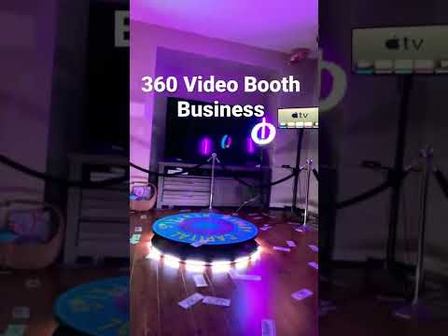
https://sites.google.com/view/360-video-booth-rental-arcadia/home

Slide 9
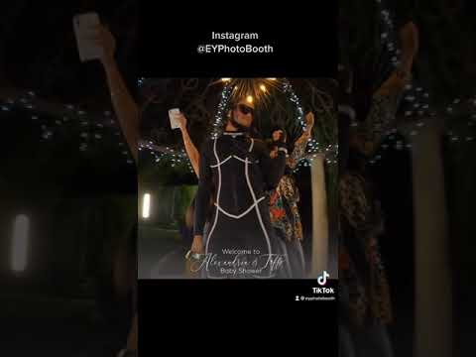
https://sites.google.com/view/360-video-booth-rental-arcadia/home

Slide 10
https://sites.google.com/view/360-video-booth-rental-arcadia/home

Slide 11
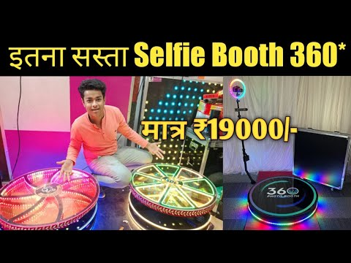
https://sites.google.com/view/360-video-booth-rental-arcadia/home

Slide 12
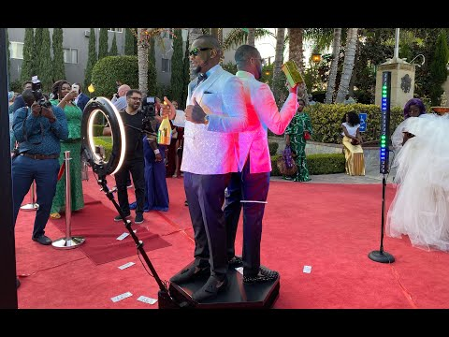
https://sites.google.com/view/360-video-booth-rental-arcadia/home

Slide 13
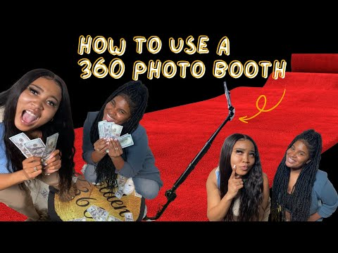
https://sites.google.com/view/360-video-booth-rental-arcadia/home

Slide 14
https://sites.google.com/view/360-video-booth-rental-arcadia/home

Slide 15
https://sites.google.com/view/360-video-booth-rental-arcadia/home

Slide 16
https://sites.google.com/view/360-video-booth-rental-arcadia/home

Slide 17
https://sites.google.com/view/360-video-booth-rental-arcadia/home

Slide 18
https://sites.google.com/view/360-video-booth-rental-arcadia/home

Slide 19
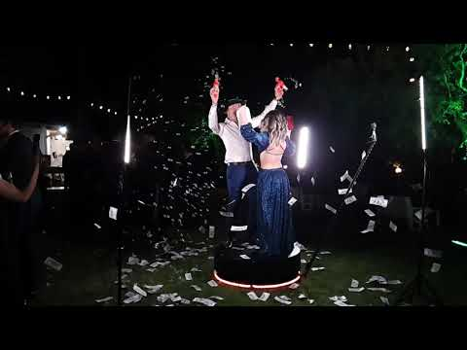
https://sites.google.com/view/360-video-booth-rental-arcadia/home

Slide 20
https://sites.google.com/view/360-video-booth-rental-arcadia/home

Slide 21
https://sites.google.com/view/360-video-booth-rental-arcadia/home

Slide 22
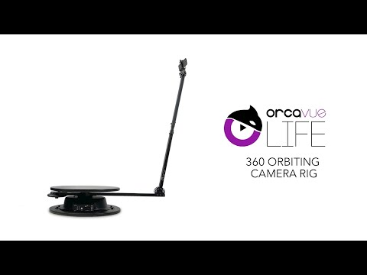
https://sites.google.com/view/360-video-booth-rental-arcadia/home

Slide 23
https://sites.google.com/view/360-video-booth-rental-arcadia/home

Slide 24
https://sites.google.com/view/360-video-booth-rental-arcadia/home

Slide 25
https://sites.google.com/view/360-video-booth-rental-arcadia/home
Notes:
https://drive.google.com/drive/folders/11FS9t4cO3mzuaRgZXZ55ix9U3FdVcwHn?usp=sharing
https://docs.google.com/document/d/17Pfl9vPBwpBSfR0UoU0OdTldB90I5lx_ig5gGJNwI8Q/edit?usp=sharing
https://docs.google.com/document/d/17Pfl9vPBwpBSfR0UoU0OdTldB90I5lx_ig5gGJNwI8Q/pub
https://docs.google.com/document/d/17Pfl9vPBwpBSfR0UoU0OdTldB90I5lx_ig5gGJNwI8Q/view
https://docs.google.com/presentation/d/1tdjZGJOE37rGEOPwGspAL0u3gbc_ss-g0b1UtyKydPo/edit?usp=sharing
https://docs.google.com/presentation/d/1tdjZGJOE37rGEOPwGspAL0u3gbc_ss-g0b1UtyKydPo/pub
https://docs.google.com/presentation/d/1tdjZGJOE37rGEOPwGspAL0u3gbc_ss-g0b1UtyKydPo/view
https://docs.google.com/document/d/19QnYAPPxW-abcJnN-I3TfPSHdZNgnp2kQNVwyEczMXA/edit?usp=sharing
https://docs.google.com/document/d/19QnYAPPxW-abcJnN-I3TfPSHdZNgnp2kQNVwyEczMXA/pub
https://docs.google.com/document/d/19QnYAPPxW-abcJnN-I3TfPSHdZNgnp2kQNVwyEczMXA/view
https://docs.google.com/presentation/d/1r_Vgs_OoDV5FS02RNWz6nEIqFePvrSLagqTDY-lmCok/edit?usp=sharing
https://docs.google.com/presentation/d/1r_Vgs_OoDV5FS02RNWz6nEIqFePvrSLagqTDY-lmCok/pub
https://docs.google.com/presentation/d/1r_Vgs_OoDV5FS02RNWz6nEIqFePvrSLagqTDY-lmCok/view
https://docs.google.com/document/d/1dkhJHG4N32f3Si8ZMHCv90F5T0uubfwcKMRi9WLAJiw/edit?usp=sharing
https://docs.google.com/document/d/1dkhJHG4N32f3Si8ZMHCv90F5T0uubfwcKMRi9WLAJiw/pub
https://docs.google.com/document/d/1dkhJHG4N32f3Si8ZMHCv90F5T0uubfwcKMRi9WLAJiw/view
https://docs.google.com/presentation/d/1hqwZxAs7xRcPoTFoVjCzzMGqEUoyl51GS7eIsFzQCtA/edit?usp=sharing
https://docs.google.com/presentation/d/1hqwZxAs7xRcPoTFoVjCzzMGqEUoyl51GS7eIsFzQCtA/pub
https://docs.google.com/presentation/d/1hqwZxAs7xRcPoTFoVjCzzMGqEUoyl51GS7eIsFzQCtA/view
https://docs.google.com/document/d/12EKzXOX9UxbW-APamcHgXDpZf9jaI04YYHT_T0YrDcI/edit?usp=sharing
https://docs.google.com/document/d/12EKzXOX9UxbW-APamcHgXDpZf9jaI04YYHT_T0YrDcI/pub
https://docs.google.com/document/d/12EKzXOX9UxbW-APamcHgXDpZf9jaI04YYHT_T0YrDcI/view
https://docs.google.com/presentation/d/1EWzma3V-gaypjpMUd7m-q-21rMNhVLWJaiVCI3tCsj4/edit?usp=sharing
https://docs.google.com/presentation/d/1EWzma3V-gaypjpMUd7m-q-21rMNhVLWJaiVCI3tCsj4/pub
https://docs.google.com/presentation/d/1EWzma3V-gaypjpMUd7m-q-21rMNhVLWJaiVCI3tCsj4/view
https://docs.google.com/document/d/10FisUyDwvIpUJ3h9p1kJvjq4NCJmwk9tRkFOvR6exBU/edit?usp=sharing
https://docs.google.com/document/d/10FisUyDwvIpUJ3h9p1kJvjq4NCJmwk9tRkFOvR6exBU/pub
https://docs.google.com/document/d/10FisUyDwvIpUJ3h9p1kJvjq4NCJmwk9tRkFOvR6exBU/view
https://docs.google.com/presentation/d/1z-Hys4eRc3ZOt9ml88xkCEtpjpDiPZb70FD_Tr_fpHs/edit?usp=sharing
https://docs.google.com/presentation/d/1z-Hys4eRc3ZOt9ml88xkCEtpjpDiPZb70FD_Tr_fpHs/pub
https://docs.google.com/presentation/d/1z-Hys4eRc3ZOt9ml88xkCEtpjpDiPZb70FD_Tr_fpHs/view
https://docs.google.com/document/d/1STmD_qZYrQYtJyzJET3gNjFwsxXI3_nDdbANiGOPPKM/edit?usp=sharing
https://docs.google.com/document/d/1STmD_qZYrQYtJyzJET3gNjFwsxXI3_nDdbANiGOPPKM/pub
https://docs.google.com/document/d/1STmD_qZYrQYtJyzJET3gNjFwsxXI3_nDdbANiGOPPKM/view
https://docs.google.com/presentation/d/1TU5I3SMLY2RQ4NMGbP9jrGRuyumnlnY5haIb80FtpTg/edit?usp=sharing
https://docs.google.com/presentation/d/1TU5I3SMLY2RQ4NMGbP9jrGRuyumnlnY5haIb80FtpTg/pub
https://docs.google.com/presentation/d/1TU5I3SMLY2RQ4NMGbP9jrGRuyumnlnY5haIb80FtpTg/view

Slide 26
what is a 360 video booth
https://sites.google.com/view/360-video-booth-rental-arcadia/home
Notes:
360 video booth rental near me,360 video booth rental los angeles,360 video booth rental price,360 video booth price,360 video booth automatic,what is a 360 video booth,360 video booth business,360 video booth cost,360 degree photo booth video,360 experience video booth,360 video booth for rent,360 grad video booth,360 video booth hire,360 video booth with ring light,orcavue life 360 video booth,360 video booth near me,revolve 360 video booth near me,360 slow motion video booth

